Slide 1
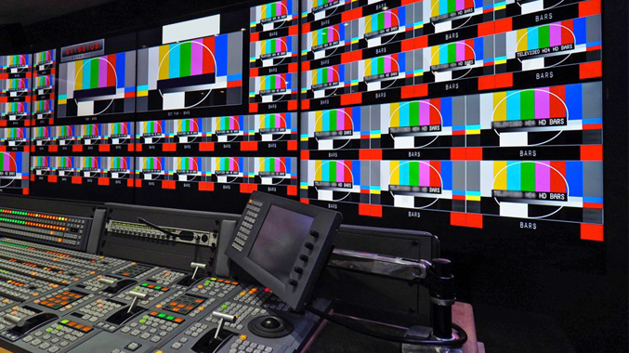
Outside Broadcasting
Maria Wahab and Richard Ludford

Slide 2
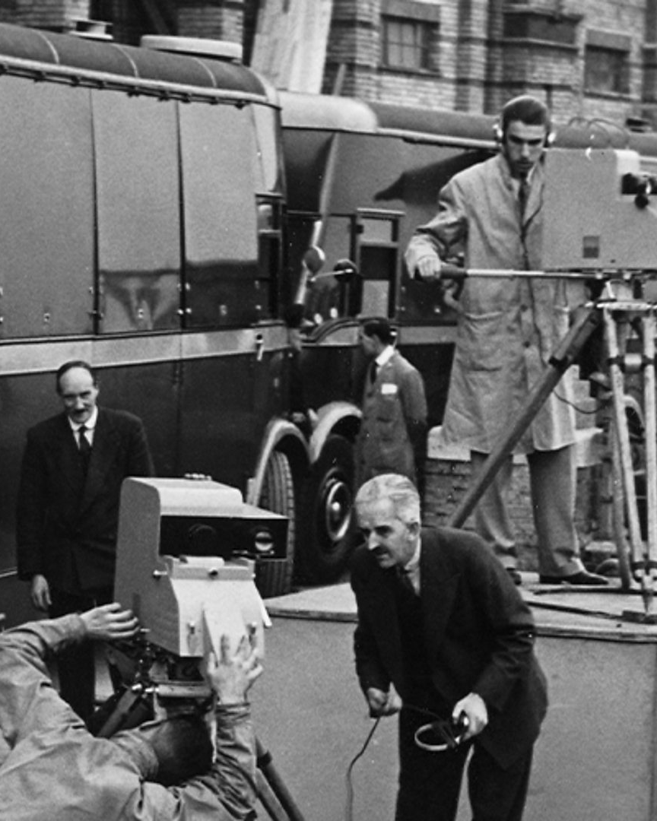
What is OB
Outside Broadcasting (OB) is the production and transmission of outside-of-studio live events.
The First OB was the Coronation procession of King George VI and Queen Elizabeth in 1937.
Its now used in:
- Live sporting events
- Live news
- Special events, like royal weddings
- Live music festivals

Slide 3
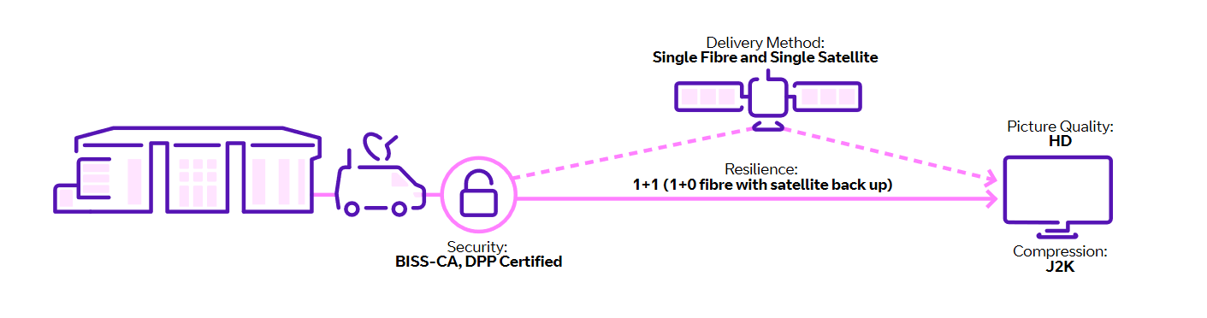
Overview of the OB process
Starts with the Camera
Camera feed goes into the OB truck, where edititing and stuff can happen – alternatively could be sent directly to the studio to be edited
Feed sent to studio, generally via satellite or fibre

Slide 4

How is data transmitted?
Broadcasters use MPEG-2 compression on audio and visual signals before transmitting the digital signals
Each broadcaster has one digital TV channel which can stream at 19.39Mbps
Broadcasters typically will divide this up into three or four sub-channels
Prime time television programs and sport can consume the entire 19.39Mbps to give greater picture quality

Slide 5
Equipment for OB
In outside broadcast much of the same equipment as studio broadcast is used
Some of the equipment includes:
Audio mixer – combines multiple audio signals from different microphones into a common output
Video mixer – used during live events where multiple video sources need to be mixed in real time
Modulator – modifies the wave to transmit over larger distances
Digital TV transmitter – carrying video signal
Routing – used for selecting a path for signals
Media servers – used to store graphics and clips to be inserted into the broadcast

Slide 6
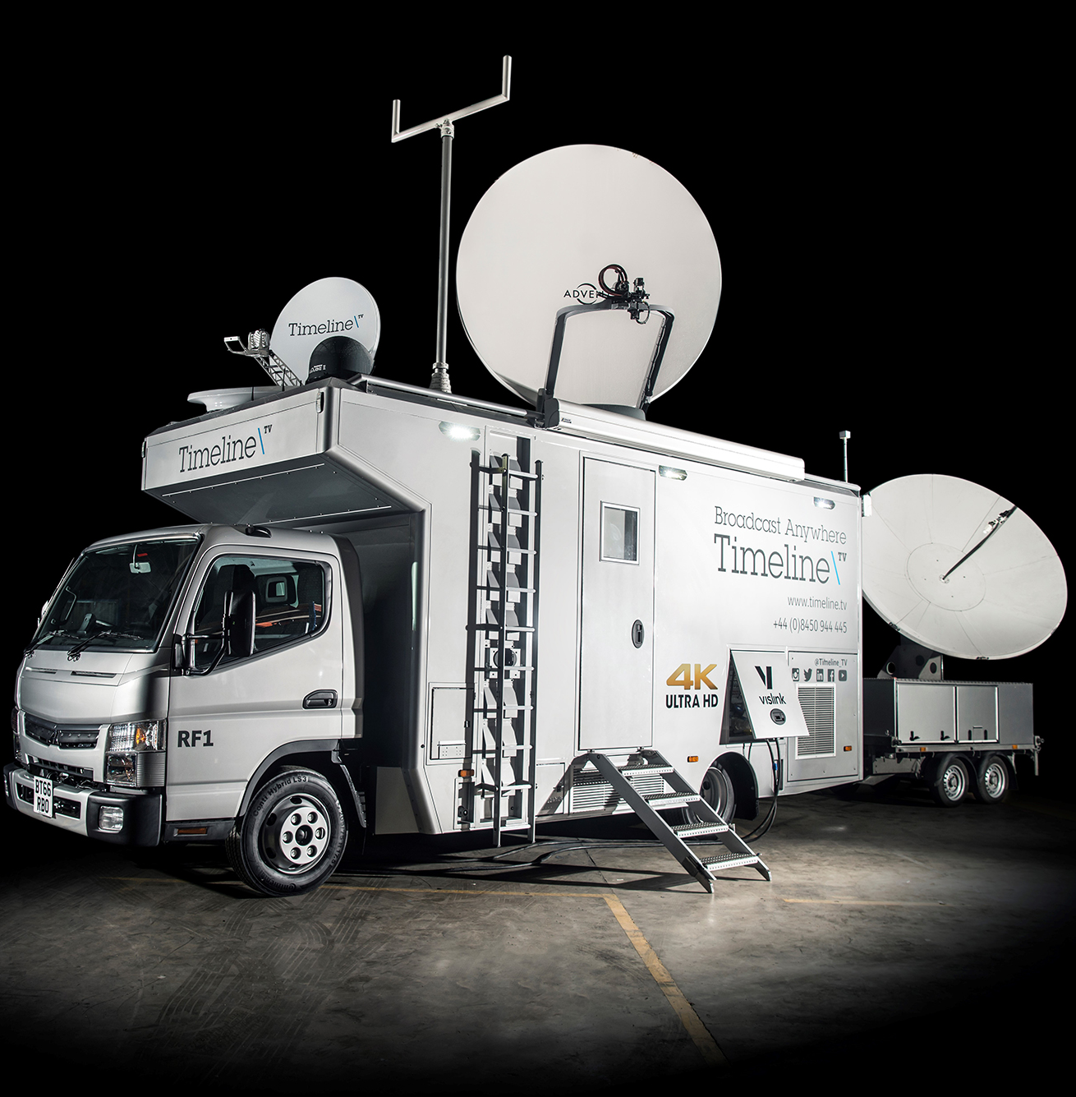
Production trucks
They’ve been around since the beginning of outside broadcasting
Used when something is being produced outside of the studio

Slide 7
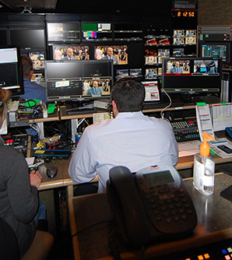
Production trucks
Typically split into 5 sections
Production – the programme is produced, computer graphics are added
Sound – Audio is edited
VTR – Records the output, used for replays
Racks/ engineering – in charge of looking after anything technical
Transmission – data is transmitted to the station, either through fibre or satellite link

Slide 8
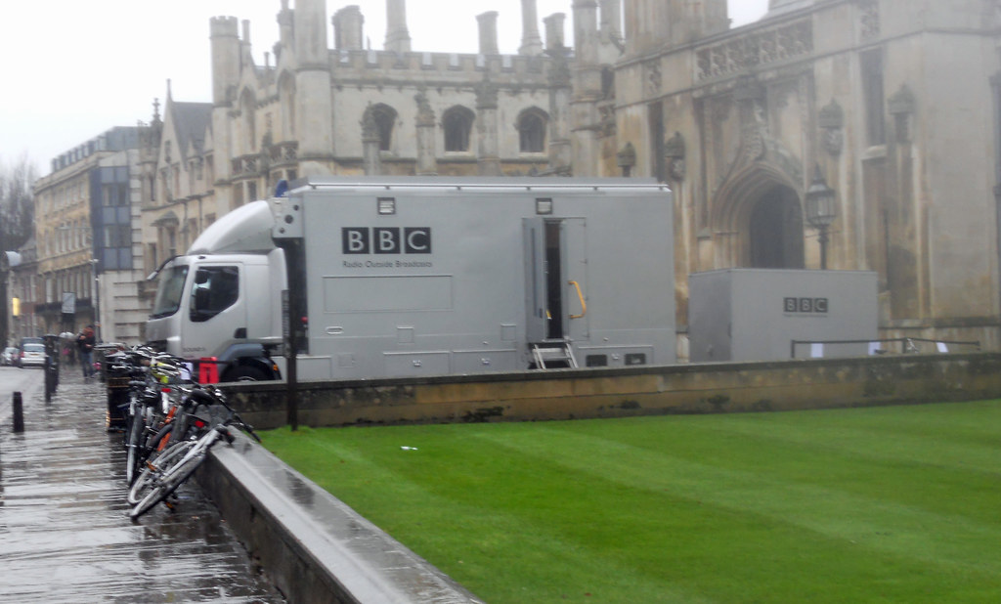
Challenges of OB
The weather and environment – equipment could get damaged
Electrical requirements – broadcasting requires a lot of energy
Lighting – Needed for good video
Cabling – cables can get very long – needs to be properly installed and right for the job.
Efficiency – everything needs to be done in a safe and timely manner.

Slide 9
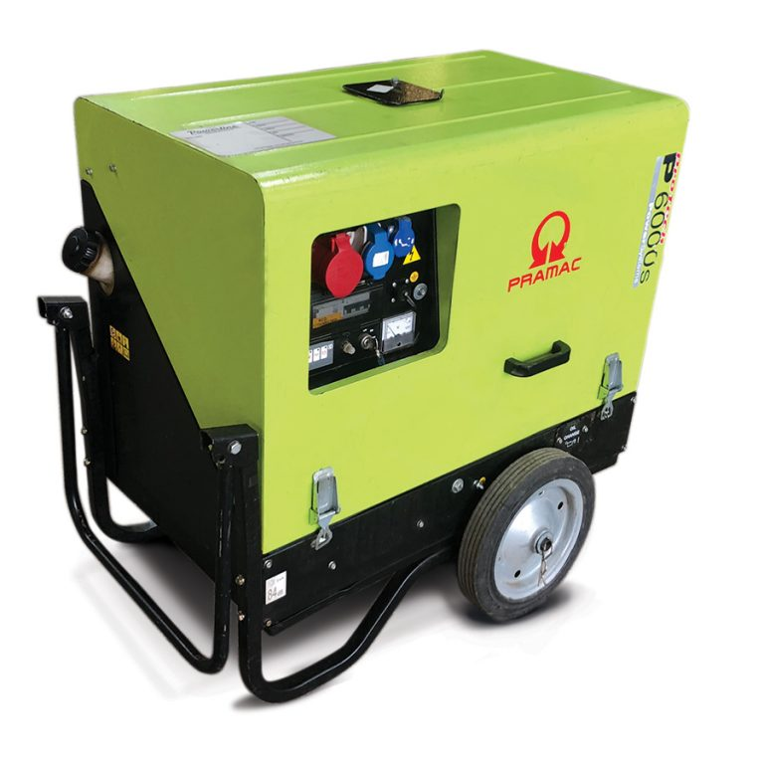
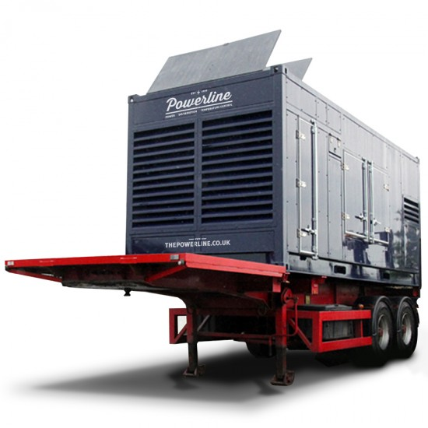
Power requirements
Outside broadcasts have lots of equipment that needs a power supply
Due to the nature of outside broadcasts the power supply they use needs to be relatively small and portable
This can be done using a local power source connected to a power distribution box which connects to all the equipment requiring power
Outside broadcasts in remote areas can use portable generators of different sizes to provide power if no local source is available

Slide 10
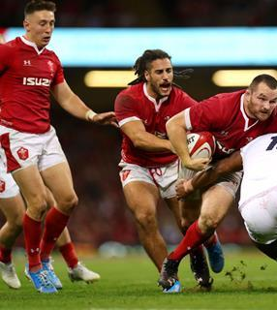
Things that are changing in outside broadcasting
Satellite is becoming less popular, with fibre being used more
Better technology leading to faster speeds, and higher quality images, like the 8k rugby game
Increasing use of IP in the transmission workflow
Possibility of using 5G to streamline the video streaming process

Slide 11
Bibliography
https://www.digitalstudiome.com/article-7102-outside-broadcasting
https://www.bbc.co.uk/blogs/genome/entries/5874fb19-fb44-4d9e-8de4-8984c077b0d4
https://download.projectandmaterials.com/outside-broadcasting
https://www.mediaandbroadcast.bt.com/news-and-events/news/project-restart.html
https://mybroadband.co.za/news/broadcasting/310315-how-supersport-broadcasts-sport-behind-the-scenes.html
https://newsroom.bt.com/bt-sport-and-samsung-deliver-first-ever-live-8k-sports-broadcast-in-the-uk/
https://www.nepgroup.co.uk/project/ip-solutions-part-4-ip-enabled-ob-trucks-flypacks-in-the-uk
https://www.telecomtv.com/content/news/ee-kicks-off-its-5g-era-with-a-live-5g-enabled-outside-broadcast-35320/
https://electronics.howstuffworks.com/dtv3.htm
https://www.rubberbox.co.uk/blog/rubber-box-outside-broadcasts-corporate-events/
https://www.essentialsupplies.co.uk/blog/what-is-a-power-distribution-unit-and-why-do-i-need-one/
https://www.generatorhire.uk.com/outside-broadcast

